Slide 1
ANL488 BA Applied Project
Supervisor Meeting #2
Low Kai Boon Calvin
Project Title: Prediction of the feasibility of potential CO2 storage locations
Progress:
 | 10% |  | 20% |  | 30% |  | 40% |  | 50% |  | 60% |  | 70% |  | 80% |  | 90% |  | 100%

Slide 2
Progress Report
Progress since last meeting
Finished initial modelling on the dataset
Constructed two types of predictive models: CART and ANN
Constructed ensemble models for each type of predictive model
CART: Bagging, AdaBoost, Random Forest
Ann: Bagging, AdaBoost
Finished evaluating the initial models
Using classification report
Using a confusion matrix

Slide 3
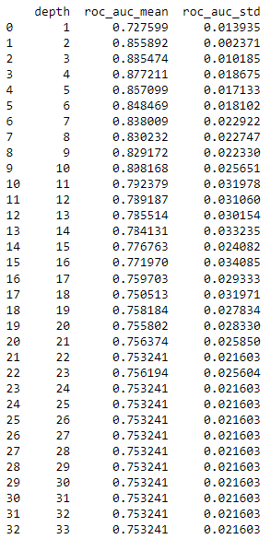
Progress Report (Using the ROC – AUC Score)
The decision tree with the highest ROC-AUC score will be chosen.

Slide 4
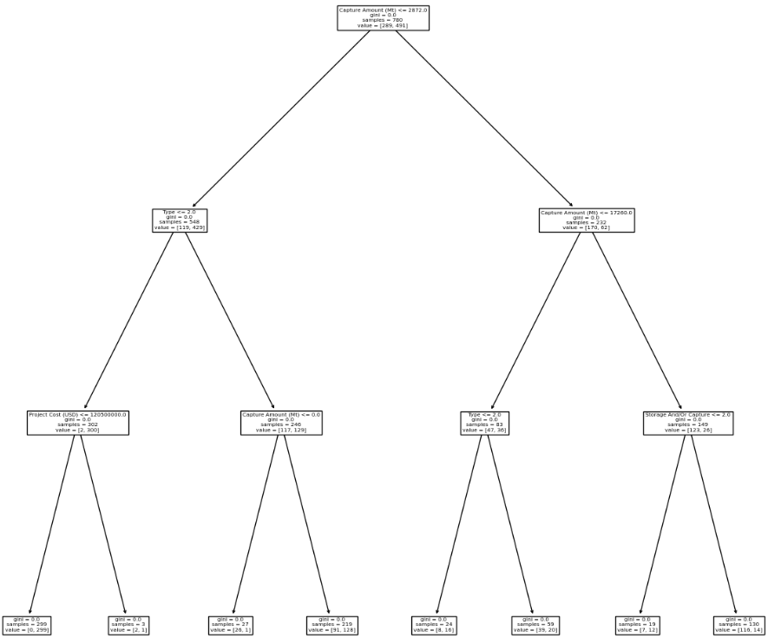
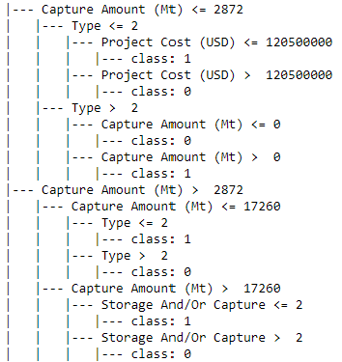
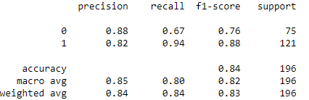
Progress Report (CART)
max_depth = 3
Overall Accuracy Rate = 83.67%

Slide 5
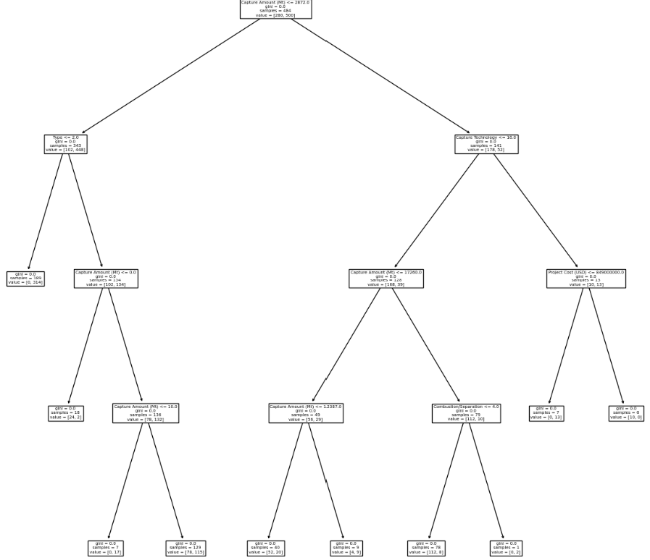
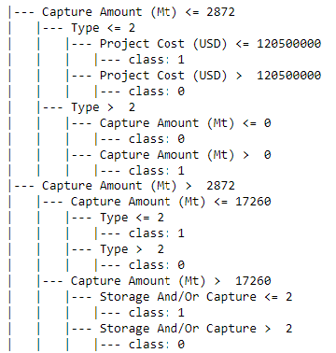
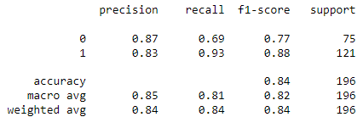
Progress Report (CART with Bagging)
max_depth = 4
Overall Accuracy Rate = 84.18%

Slide 6
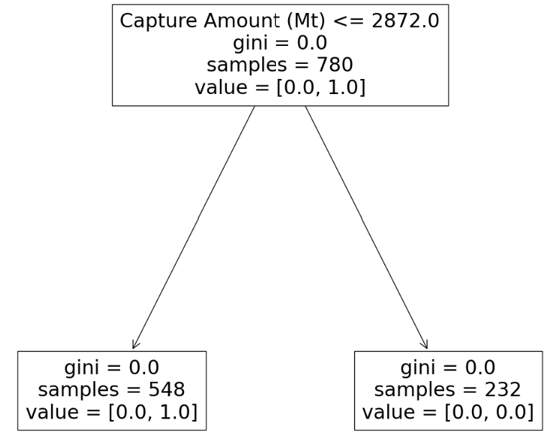

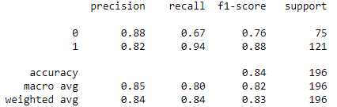
Progress Report (CART with AdaBoost
max_depth = 1
Overall Accuracy Rate = 83.67%

Slide 7
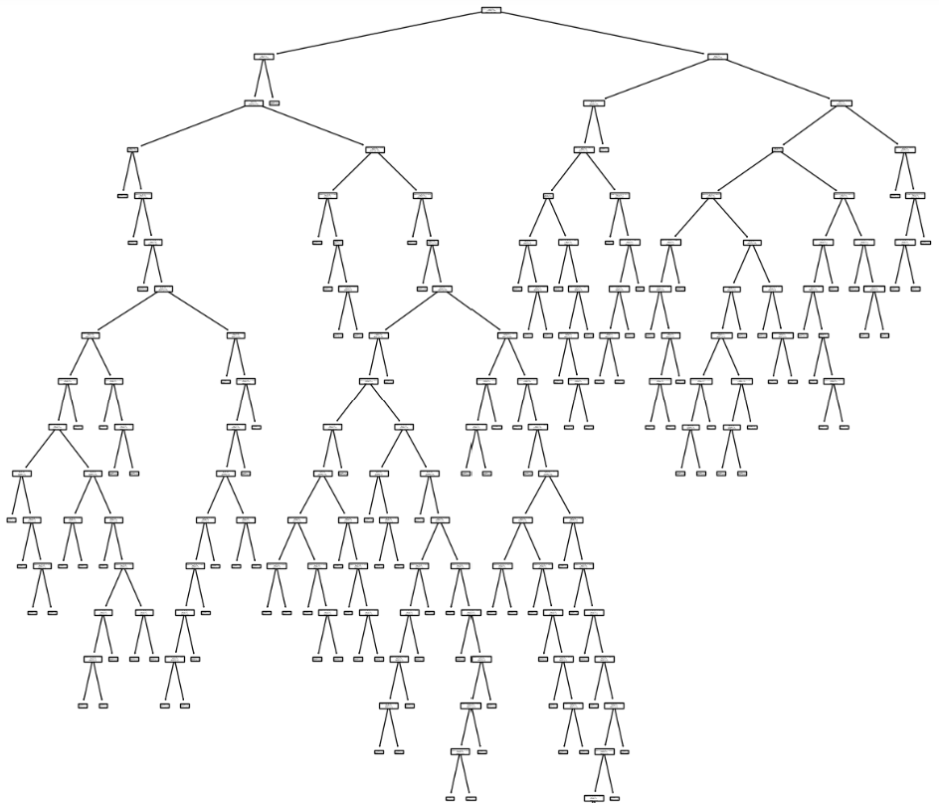
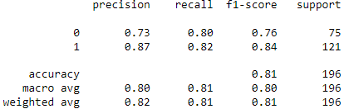
Progress Report (CART with Random Forest)
Overall Accuracy Rate = 81.12%

Slide 8
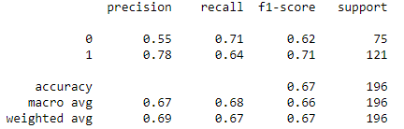
Progress Report (ANN)
Overall Accuracy Rate = 66.84%

Slide 9
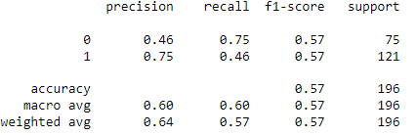
Progress Report (ANN with Bagging)
Overall Accuracy Rate = 57.14%

Slide 10
Updates
Goals until next meeting
Improve modelling
Start Final Report

Slide 11
Learning
Use sckit-learn to build predictive models
DecisionTreeClassifier
MLPClassifier
BaggingClassifier
AdaBoostClassifier
RandomForestClassifier
Using sckit-learn to evalute predictive models
classification_report
confusion_matrix

Slide 12
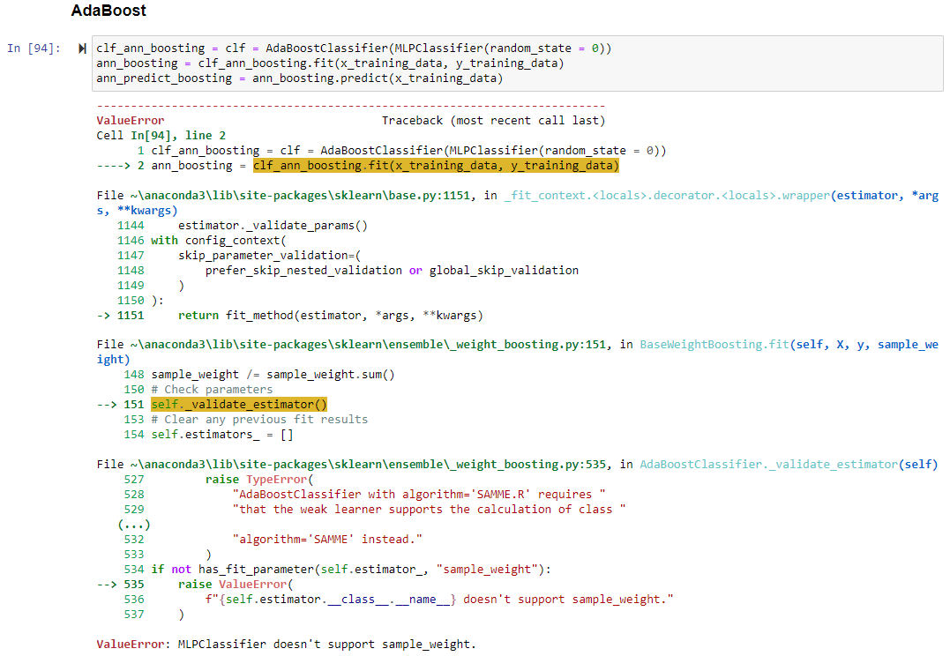
Challenges
Errors encountered when building Adaboost for ANN

Slide 13
Concerns
Results of predictive models prone to changes when rerunning Python code

